Slide 1
Operations Analytics Course Project Description
Amusement Park Simulation

Slide 2
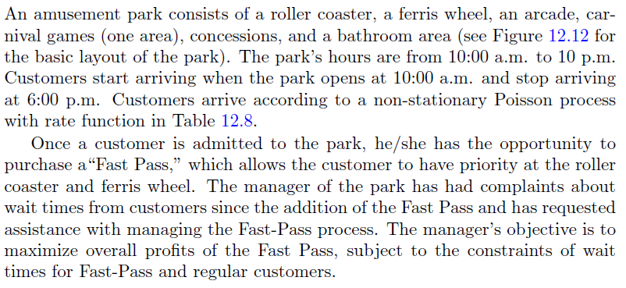
Problem Description

Slide 3
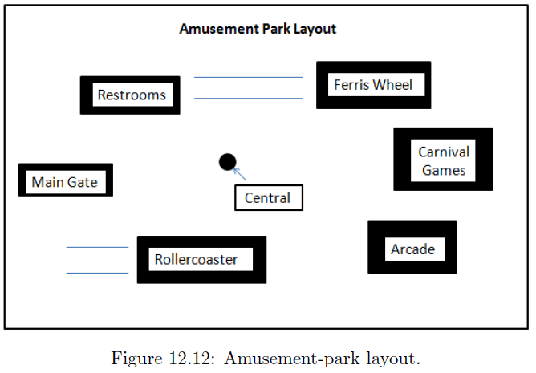

Slide 4
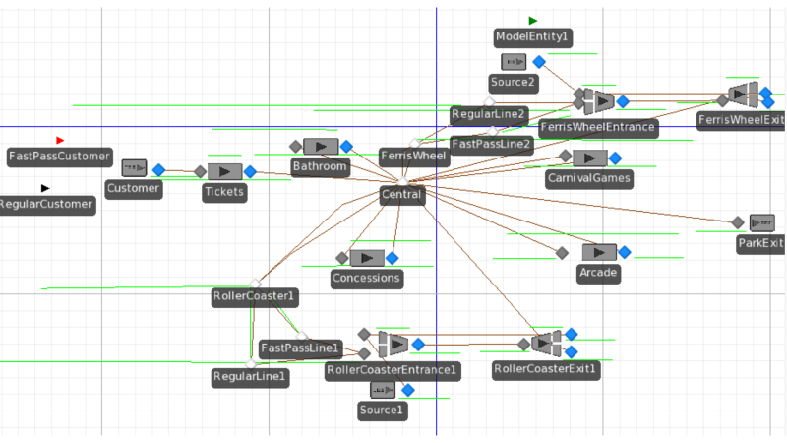
A Sample Facility View From the Book

Slide 5
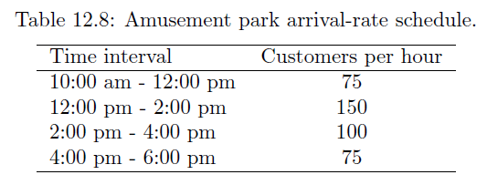

Slide 6
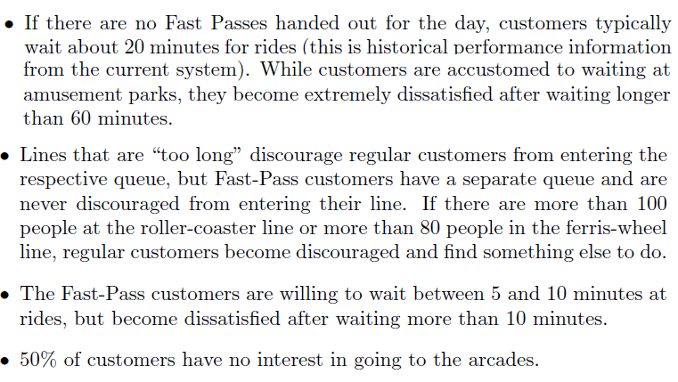
Additional Information

Slide 7
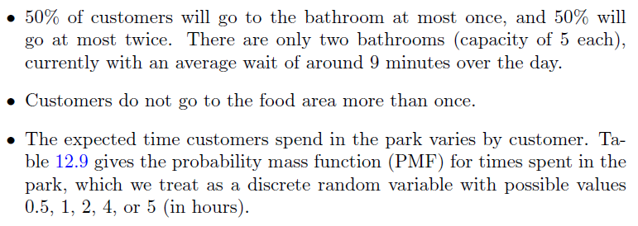
Additional Information (Cont’d…)

Slide 8
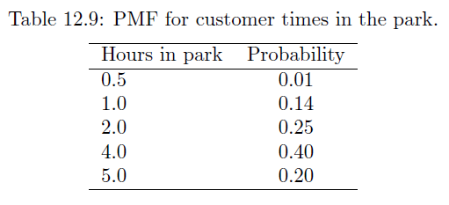

Slide 9
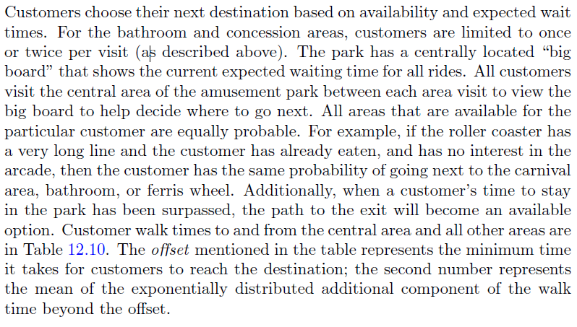
Customer Travel Times and Area Preferences

Slide 10
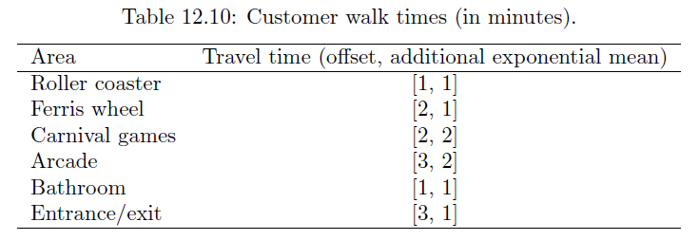

Slide 11
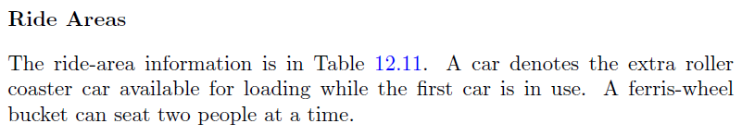
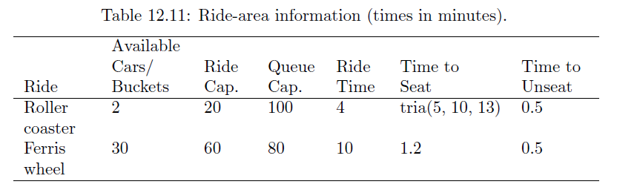
Ride Areas

Slide 12
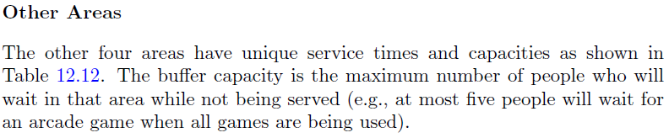
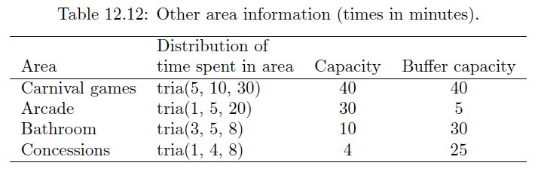
Other Areas

Slide 13
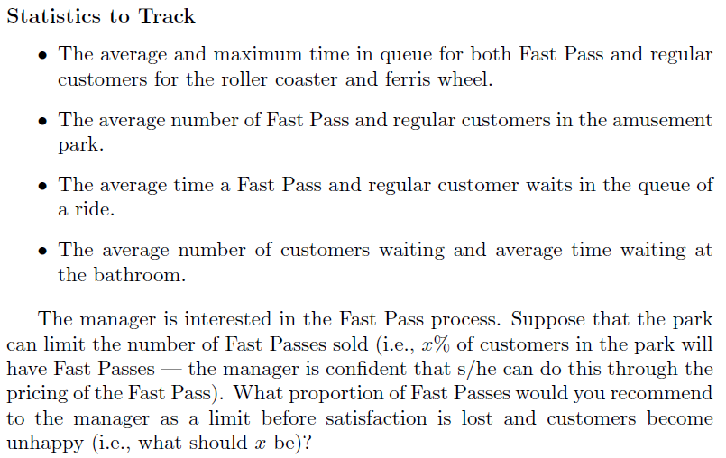
Statistics to Track

Slide 14
Model Specifications
Replication Run Length: 12 hours
Base time units: minutes
100 replications
We expect the waiting times for Regular and Fast Pass customers to increase as we increase the number of Fast Pass customers in the park.
To test this, add a property that controls the proportion of Fast Pass customers, and study average regular and fast pass customer wait times by % of Fast Pass customers

Slide 15
Final Project Model and Report Grading Rubric
Fast-Pass vs. Regular Customer Distinction, Fast-Pass prioritization (8/8)
Waiting line avoidance above the given limits, wait line balking (8/8)
Recording and collecting fast-pass and regular customer wait times individually (8/8)
Modeling fast-pass customer percentage in the model, experimentation utilizing various levels (8/8)
Assigning satisfaction category for each customer type depending on roller-coaster and Ferris-wheel wait times, computing satisfied customer percentage (8/8)
Modeling and validating Time In Park, visit limitations to specific destinations (bathrooms, concessions etc. ) (8/8)
General model specifics (7/7)
Running model with no errors. The model does what is suggested in the report. (15/15)
Well-developed experimental design to collect necessary simulation outputs (15/15)
Well written and structured report that addresses responses to questions listed in the problem description (15/15)

Slide 16
Expectations and Rubric Regarding Presentation
Maximum 15 min screencast presentations, each member has to present his/her own part. You can upload each member's part separately. Just let me know the sequence of files. You can put a link to a word document and submit it if your video file is larger than 200 MB.
You can use following programs for your screencasts:
1. https://screencast-o-matic.com/ (First fifteen minutes free)
2. https://www.techsmith.com/video-editor.html (You can use free trial version)
3. https://www.loom.com/ (You can use free trial version)
Clear and detailed presentation of the model
Responses to questions listed in the problem description
Model run demo and presentation of results.

Slide 17
Expectations and Rubric on Project Report
Submit Simio models and a project report (10 pages max) by the due date.
Clearly present the specifics of your model (i.e. how you accomplished to model specific perspectives in the problem description)
Model complexity.
Does the model do what you suggest.
Clear and detailed responses and discussion of questions listed in the problem description.
Model includes all experiments and response variables used to answer discussion questions.

